Slide 1


Multi-threading Programming In Java
Present by: Mostafa Anbarmoo
www.java-class.ir
aparat.com/Java-class
Mostafa.Anbarmoo@gmail.com

Slide 2
Overview
What is Multithreading
Thread Class
Runnable Interface
Executor Service
Callable Interface
Advanced Concepts
Search in File Project
aparat.com/Java-class

Slide 3
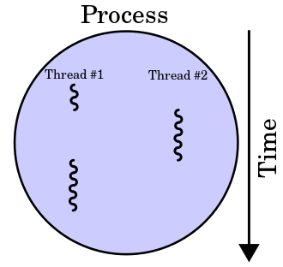
What is Multithreading?
Ability of a central processing unit (CPU) to provide multiple threads of execution concurrently.
Multi-threading enables you to write in a way where multiple activities can proceed concurrently in the same program.
different task at the same time making optimal use of the available resources
aparat.com/Java-class

Slide 4
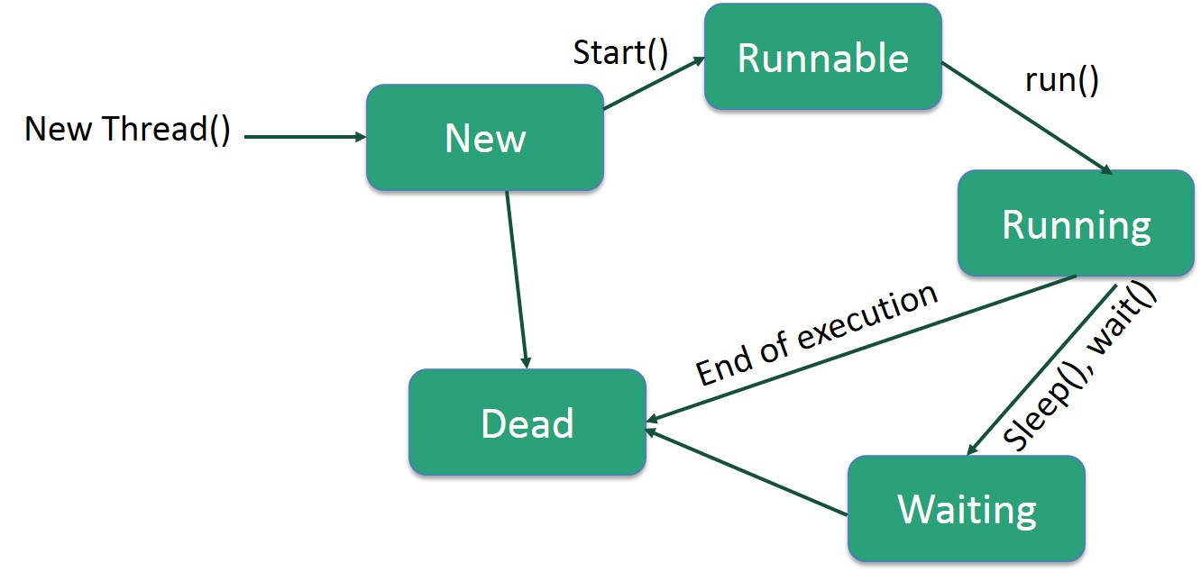
Thread
A Java Thread is like a virtual CPU that can execute your Java code
public class MyThread extends Thread {
public MyThread() {
super("MyThread");
}
public void run() {
//Code
}
}
//Started with a "new MyThread().start()" call
Thread lifecycle
aparat.com/Java-class

Slide 5
Runnable
Java runnable is an interface used to execute code on a concurrent thread.
The runnable interface has an undefined method run() with void as return type.
public class MyRunnable implements Runnable {
public void run() {
//Code
}
}
//Started with a "new Thread(new MyRunnable()).start()" call
Question: thread vs runnable?
For answer see :
https://stackoverflow.com/questions/541487/implements-runnable-vs-extends-thread-in-java
aparat.com/Java-class

Slide 6
Executor Service
The Java ExecutorService is a construct that allows you to pass a task to be executed by a thread asynchronously.
creates and maintains a reusable pool of threads for executing submitted tasks.
manages a queue, which is used when there are more tasks than the number of threads in the pool and there is a need to queue up tasks until there is a free thread available to execute the task.
Example for run 10 thread concurrent
ExecutorService executor = Executors.newFixedThreadPool(10);
aparat.com/Java-class

Slide 7
Callable
Java Callable interface is designed to define a task that returns a result and may throw an exception.
similar to the run () method of the Runnable interface, except that it returns a value and can throw a checked exception
Callable tasks return java.util.concurrent.Future objects.
class CallableExample implements Callable {
public Object call() throws Exception {
// Create random number generator
Random generator = new Random();
Integer randomNumber = generator.nextInt(5);
// To simulate a heavy computation,
// we delay the thread for some random time
Thread.sleep(randomNumber * 1000);
return randomNumber;
}
}

Slide 8
The End

